Slide 1
Car price prediction
By
SWATHI R

Slide 2
ACKNOWLEDGMENT
The internship opportunity I had with Flip Robo was a great chance for learning and professional development. Therefore, I consider myself as a very lucky individual as I was provided with an opportunity to be a part of it.
I would like to thank our SME for suggesting this project and for his whole hearted cooperation and constant encouragement throughout the project.
And I also like to thank the data trained mentors and Technical team members for helping me with the technical queries.
And these are the following website which I referred for the reference
https://www.kaggle.com/
https://scikit-learn.org/
www.stackoverflow.com
www.google.com
www.geeksforgeeks.org

Slide 3
Business Problem Framing
With the covid 19 impact in the market, we have seen lot of changes in the car market. Now some cars are in demand hence making them costly and some are not in demand hence cheaper. One of our clients works with small traders, who sell used cars. With the change in market due to covid 19 impact, our client is facing problems with their previous car price valuation machine learning models. So, they are looking for new machine learning models from new data. We have to make car price valuation model.

Slide 4
With the help of Pandas Library We will upload our data to Jupyter Notebook.
Once our Data is Scraped from the cars 24 website and used.
We have two type of variables in the data:-
Dependent Variable
Independent Variable

Slide 5
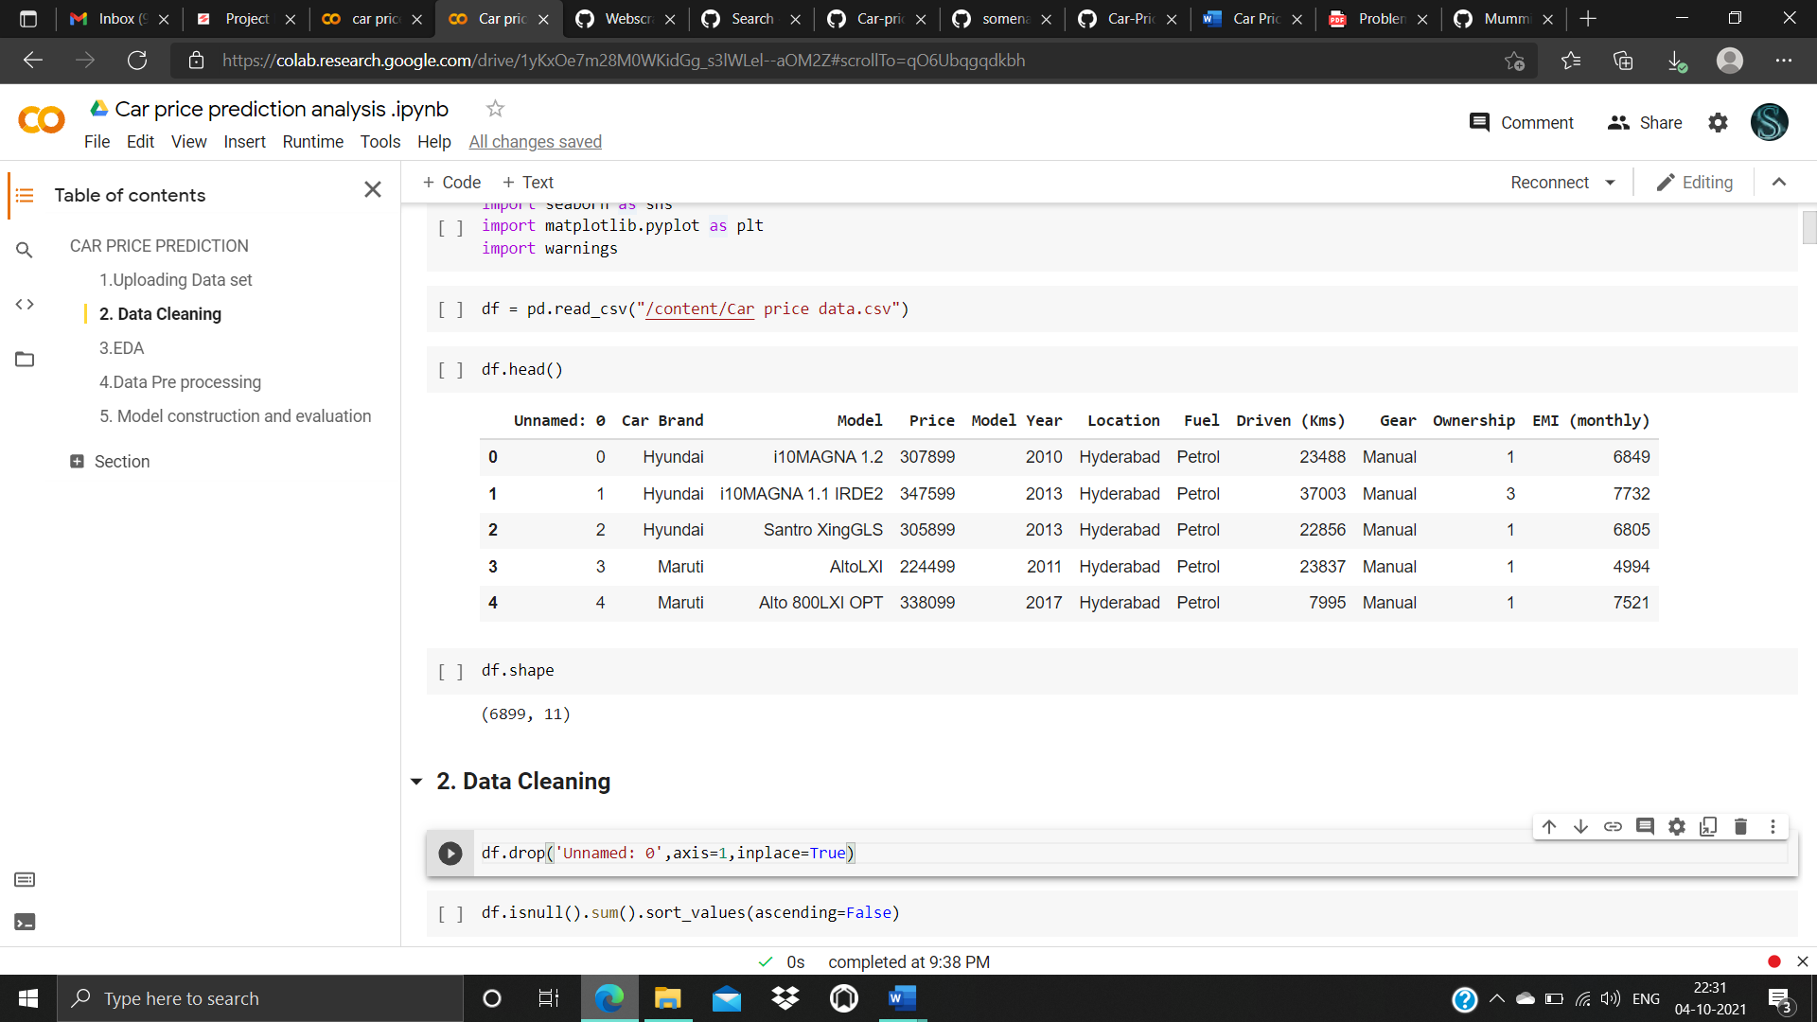
Data file

Slide 6
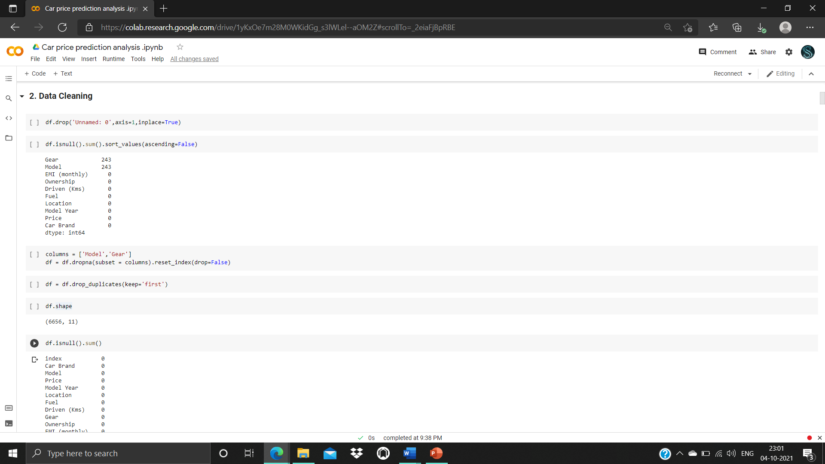
Price is an independent variable where as all of the other element are dependent variable.

Slide 7
Data Pre-processing Done
The raw data is taken and performed various steps to reduce skewness, outlier, class imbalance and scaling. There were null value was present and removed the values from the dataset. Many outlier removal and skewness removal methods are tested and best method Is chosen in order to prevent data loss.
· The dataset contains 6899 rows and 10 columns
· Price is our dependent variable.
· We created new features from old ones.
· There are no null values in the dataset.
· Removed empty cells

Slide 8
Data Inputs- Logic- Output Relationships
The input data contains 6899 rows and 10 columns.
Predictor variable are
Car Brand, Model , Model Year, Location, Fuel, Driven (Kms), Gear, Ownership, EMI (monthly)
Target variable is Price of the car

Slide 9
MODELS USED
Regression Model with following algorithms
Linear Regression
DecisionTreeRegressor
Random forest regressor
Gradient Boosting Regressor
Evaluation metrics
Mean square error
Mean absolute error
R2 score
Root Mean Squared Error

Slide 10
Testing of Identified Approaches (Algorithms)
Listing down all the algorithms used for the training and testing.
LR=LinearRegression()
DT=DecisionTreeRegressor()
GBR=GradientBoostingRegressor()
rf=RandomForestRegressor()

Slide 11
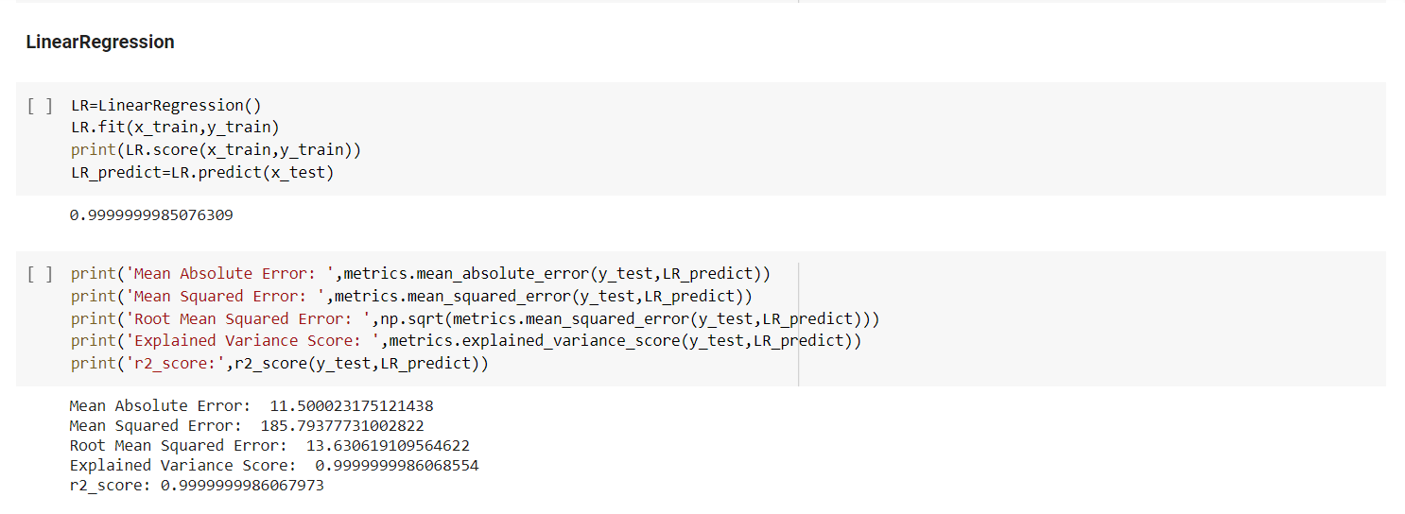
Run and Evaluate selected models
Describe all the algorithms used along with the snapshot of their code and what were the results observed over different evaluation metrics.
1.Linear Regressor

Slide 12
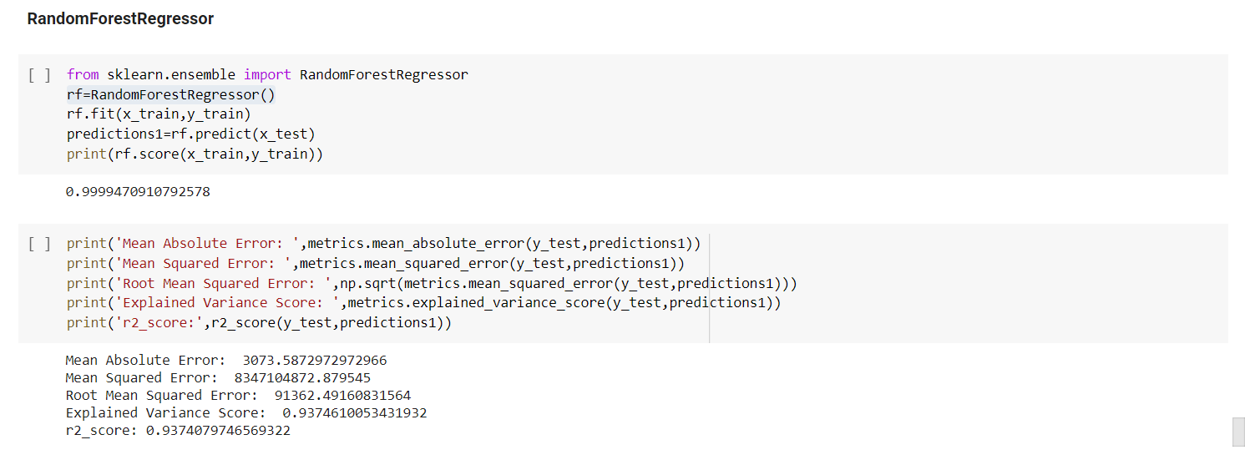
2.Random Forest Regressor

Slide 13
3. Decision Tree

Slide 14
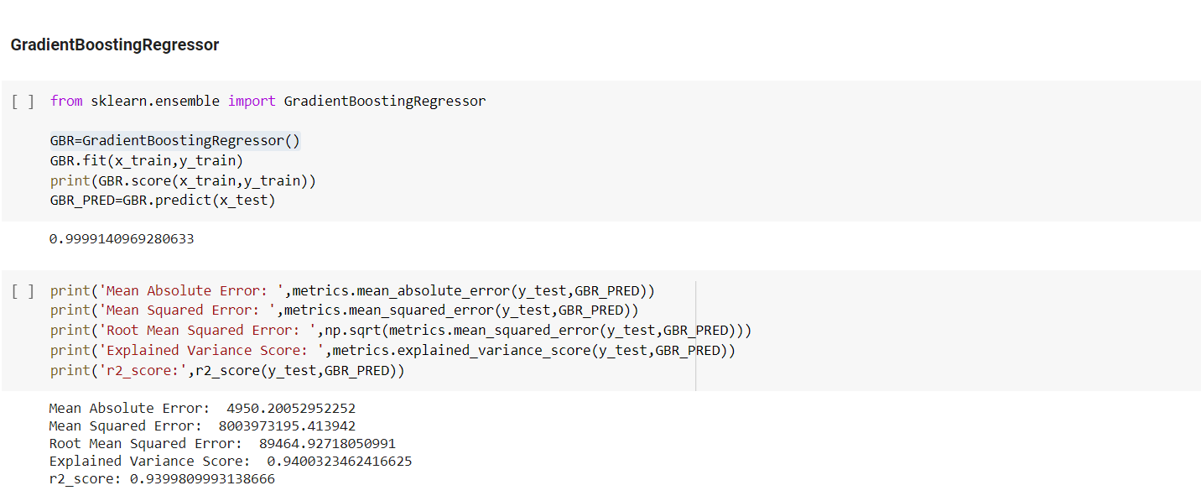

Slide 15
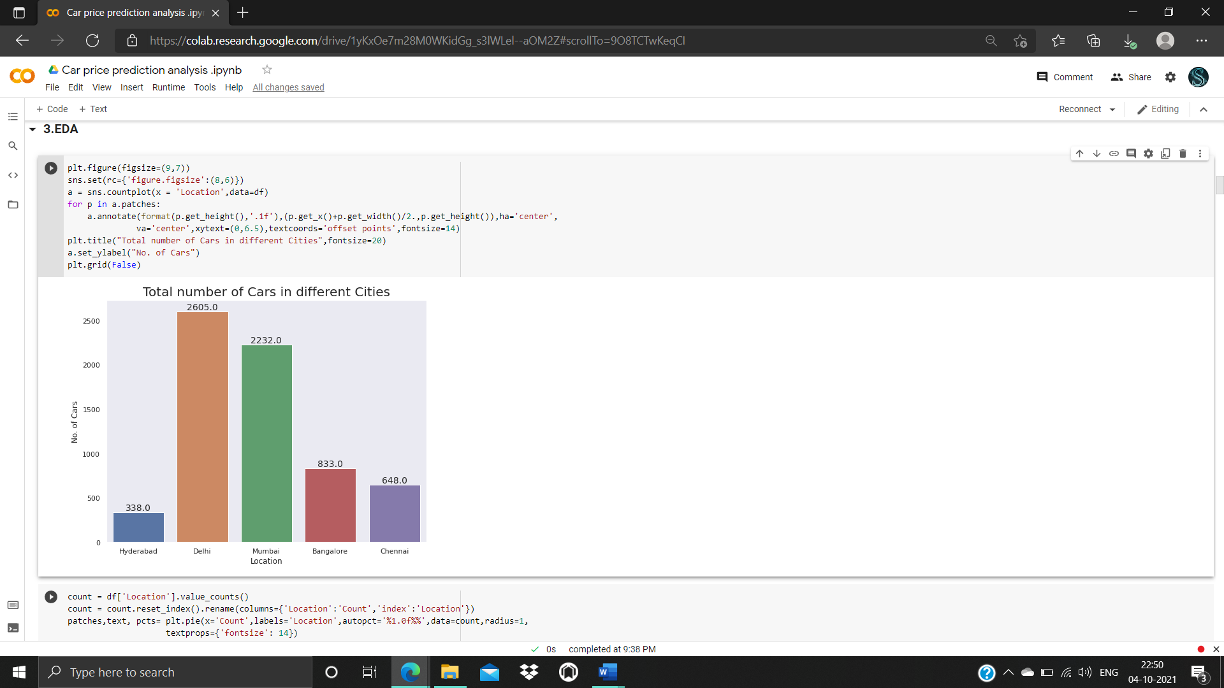
Visualizations

Slide 16
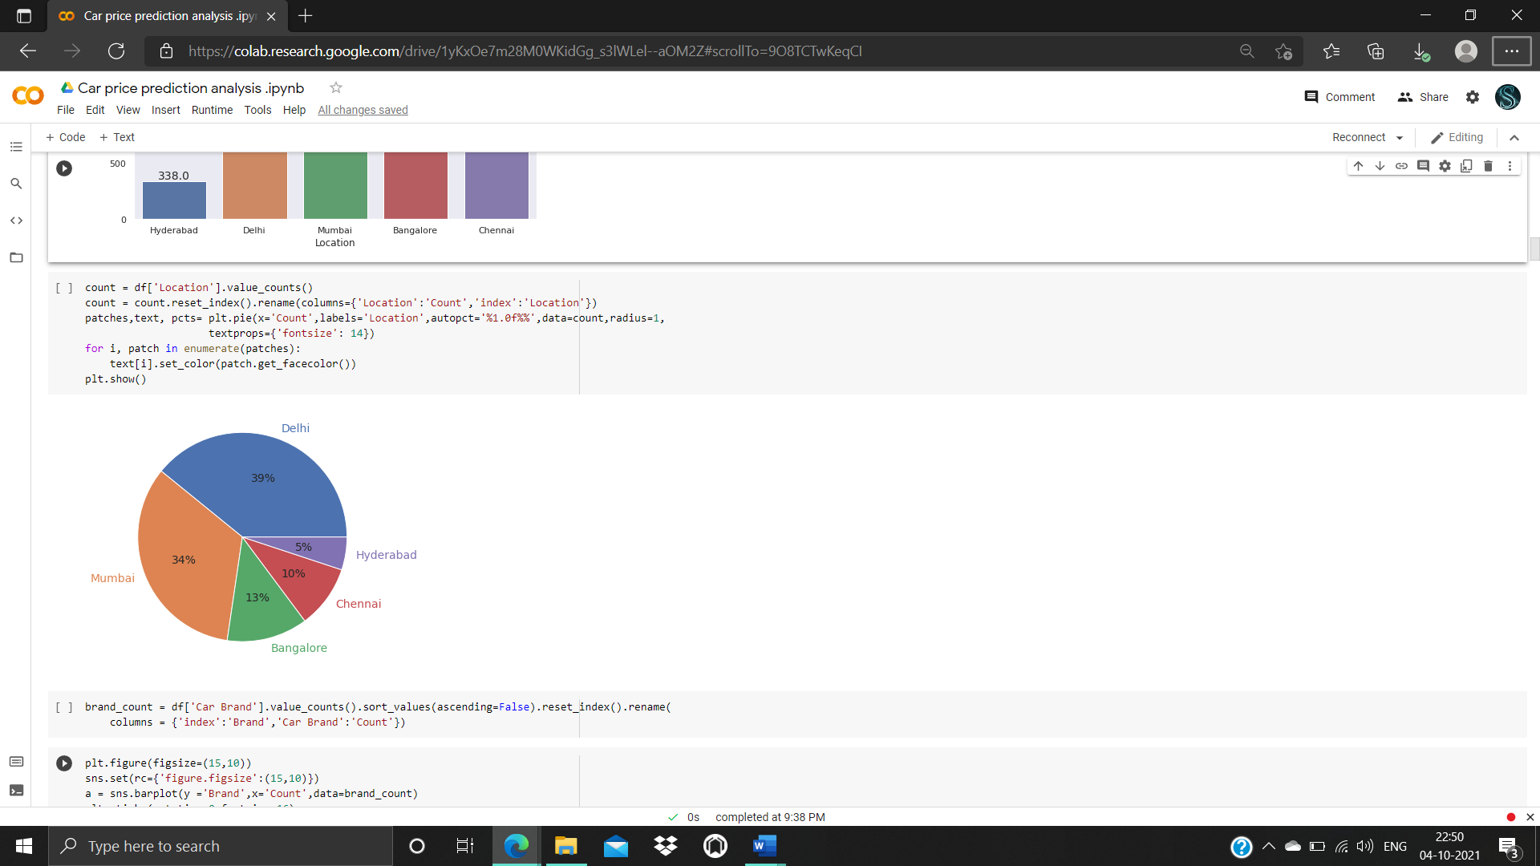

Slide 17
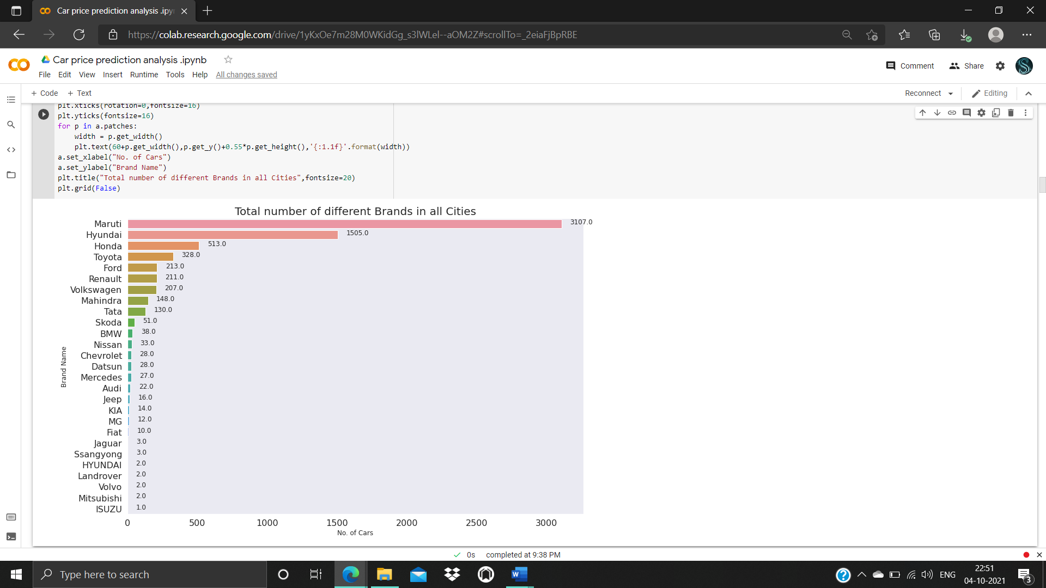

Slide 18
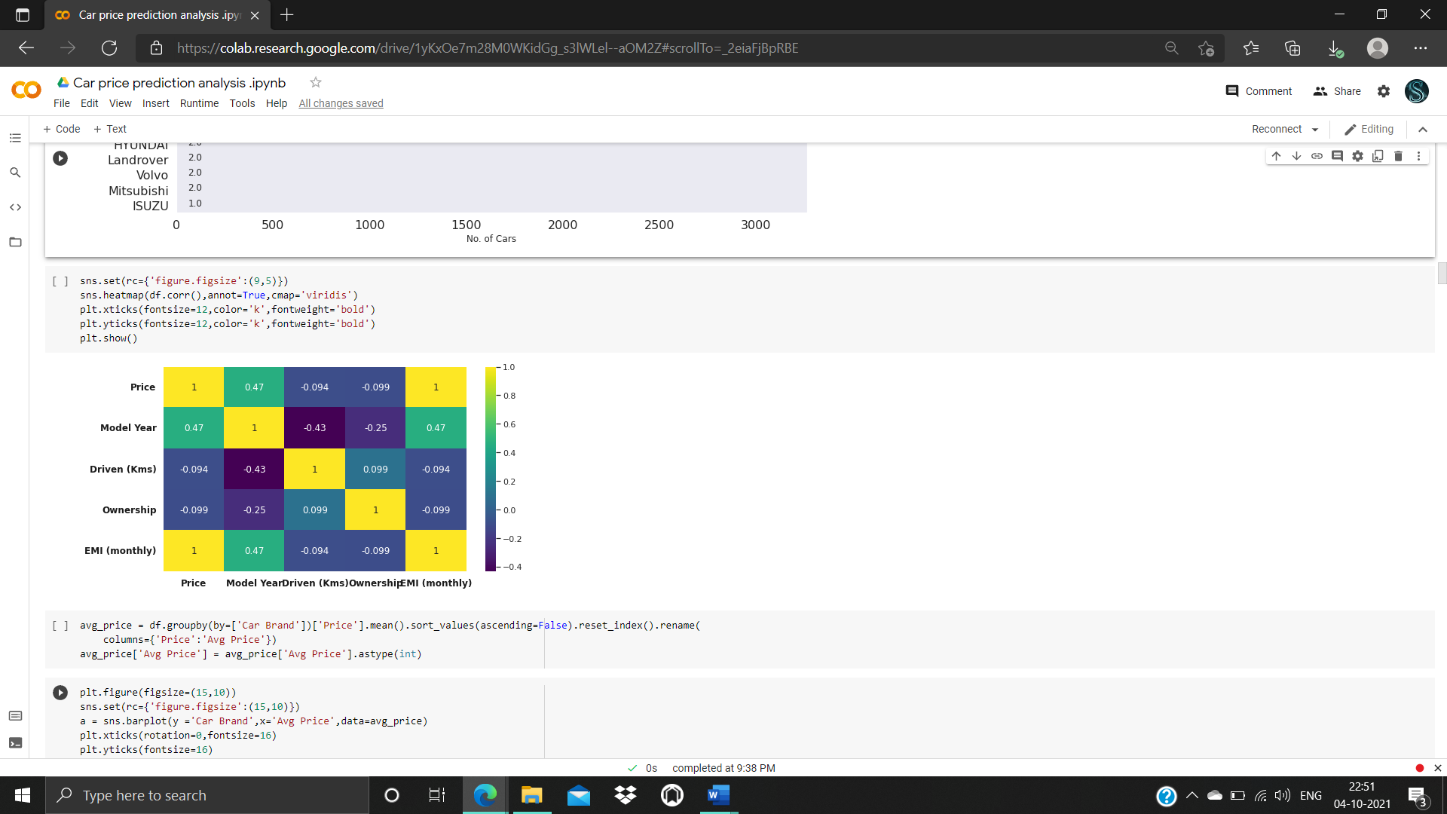

Slide 19
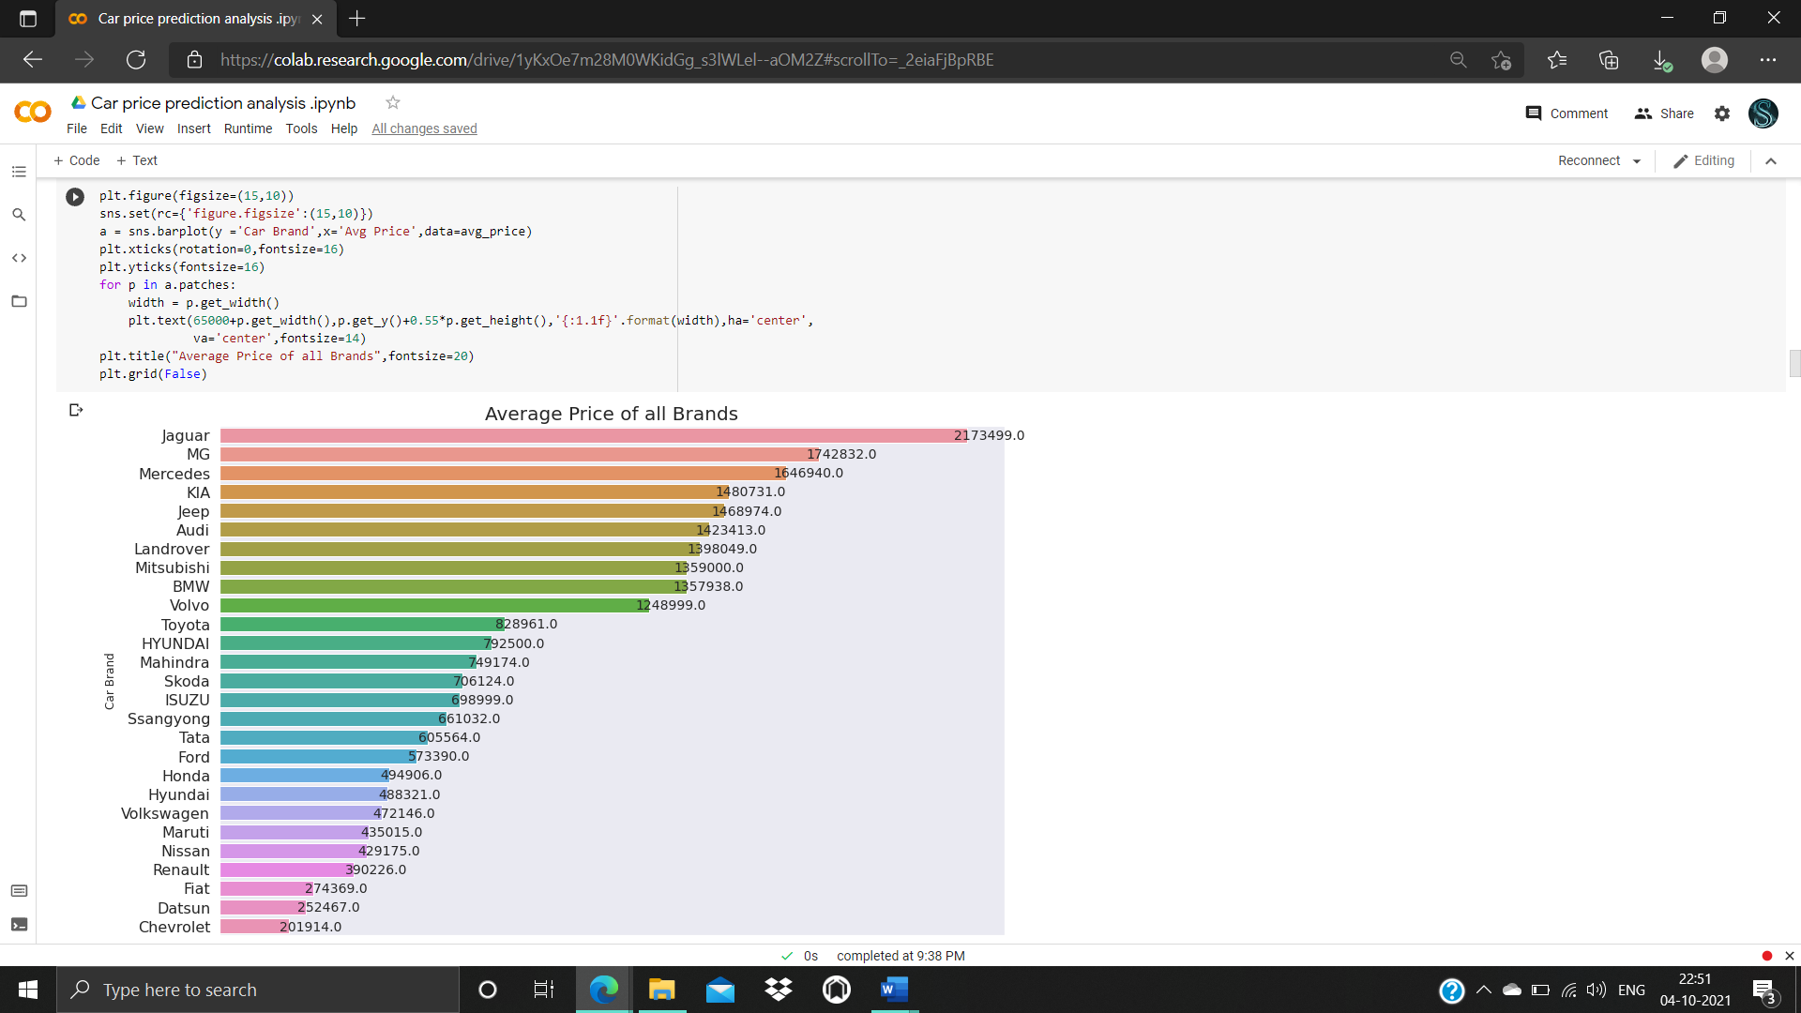

Slide 20
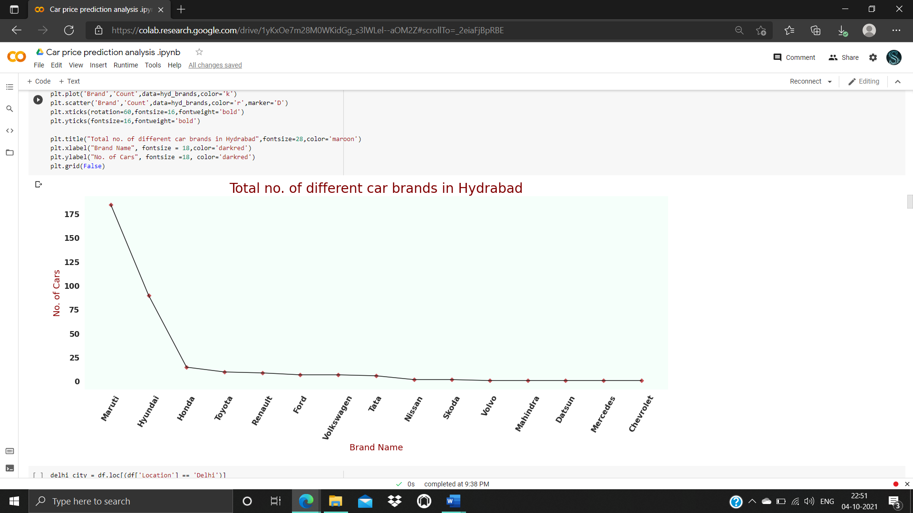

Slide 21
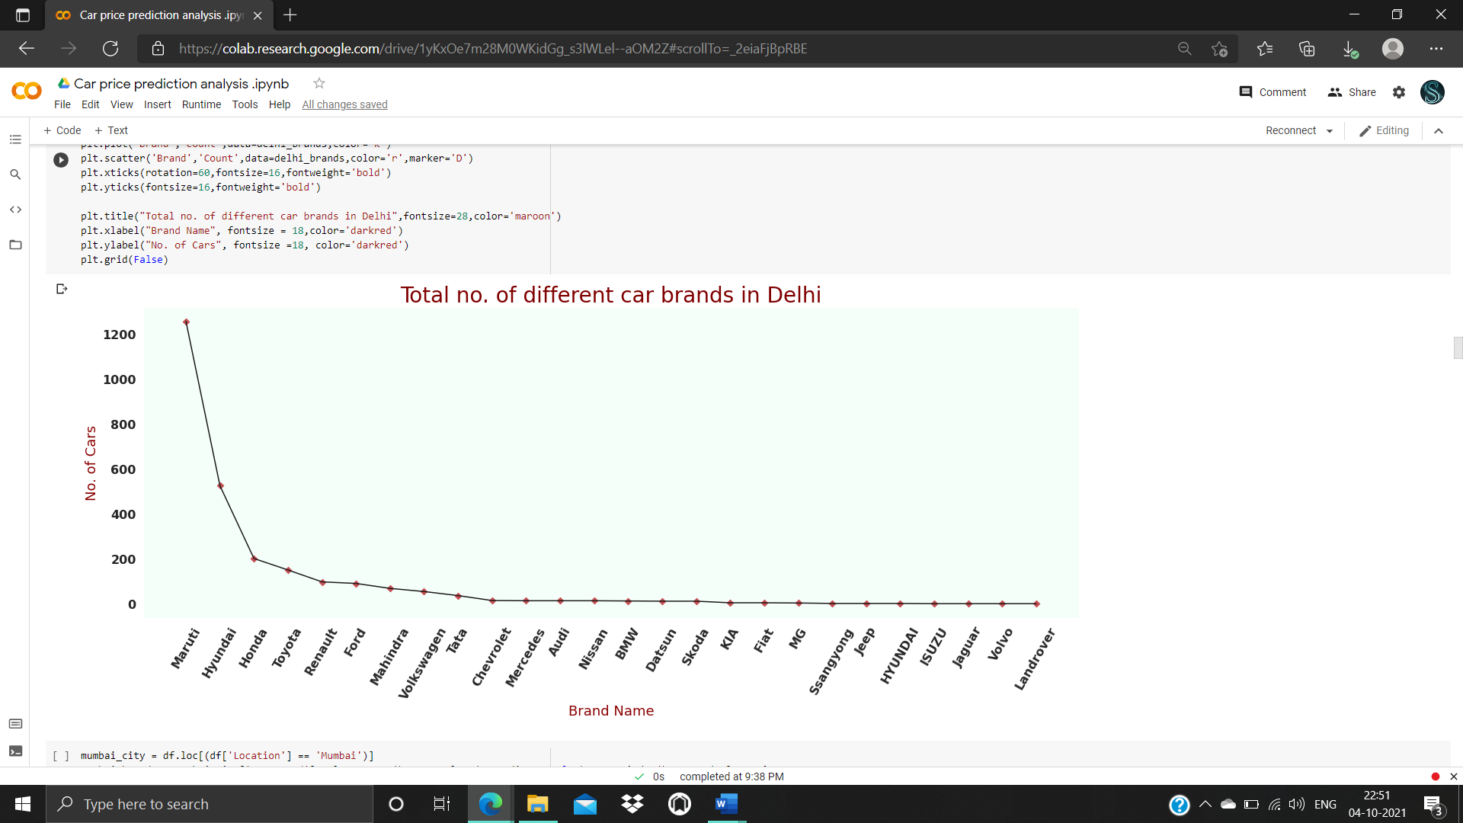

Slide 22
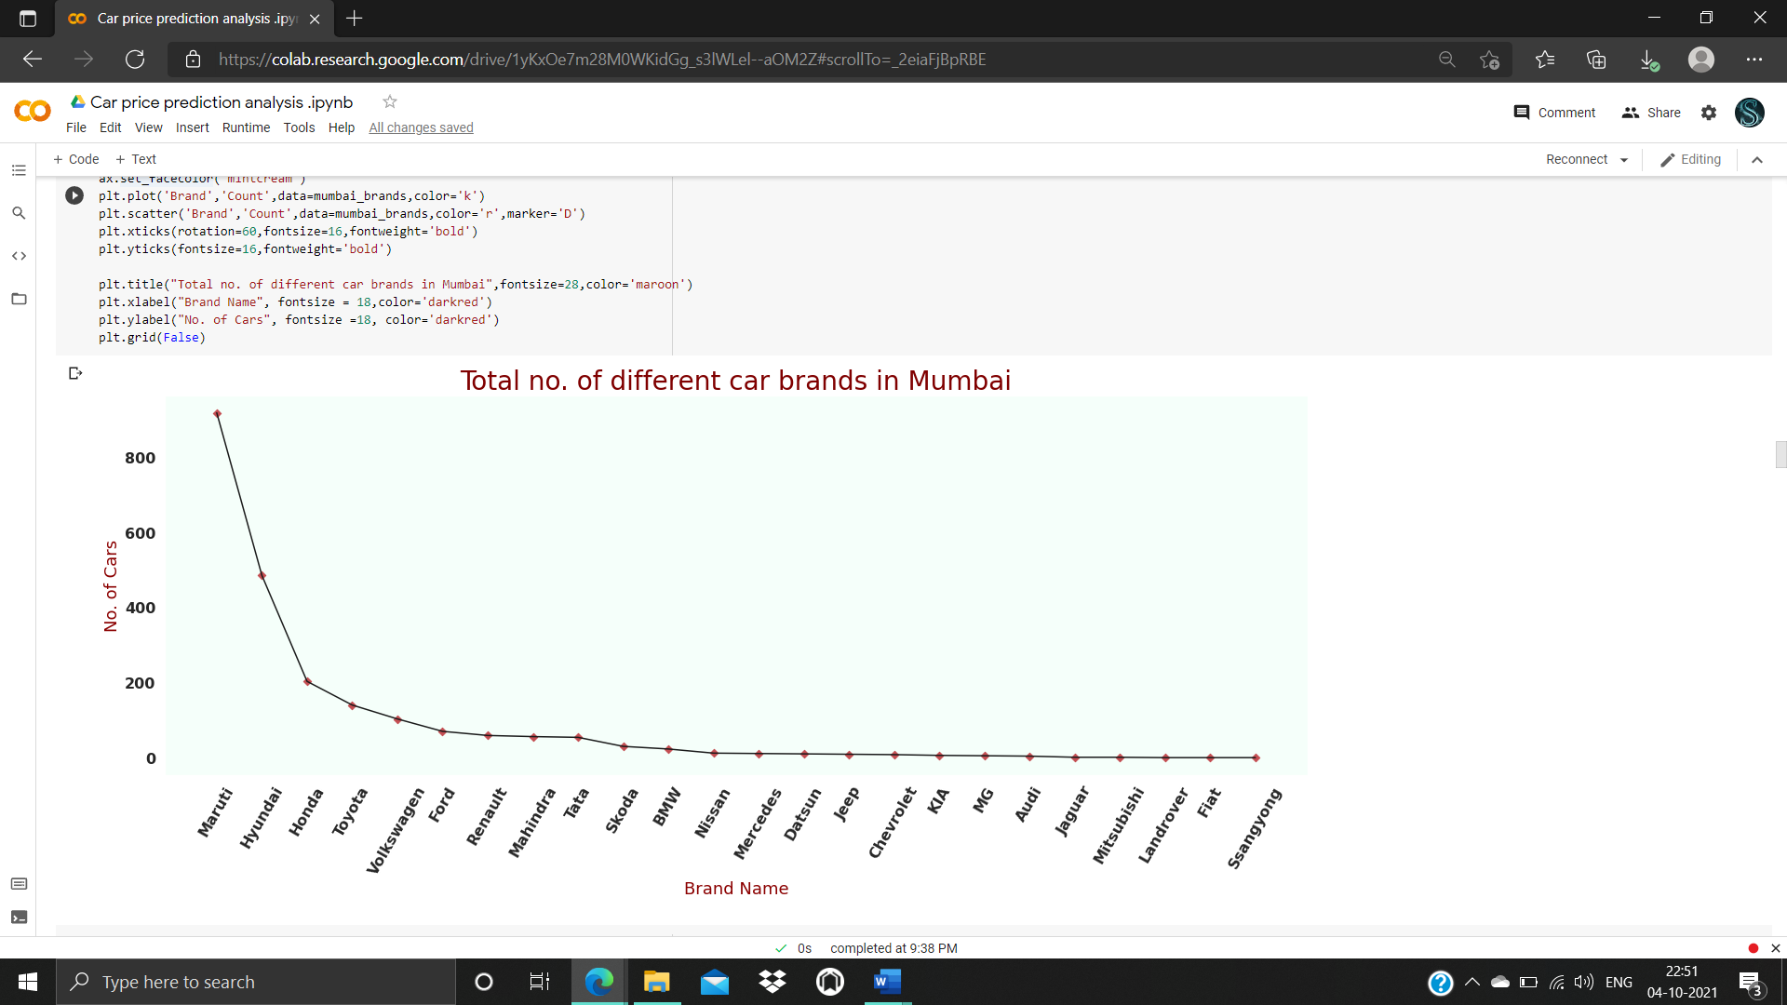

Slide 23
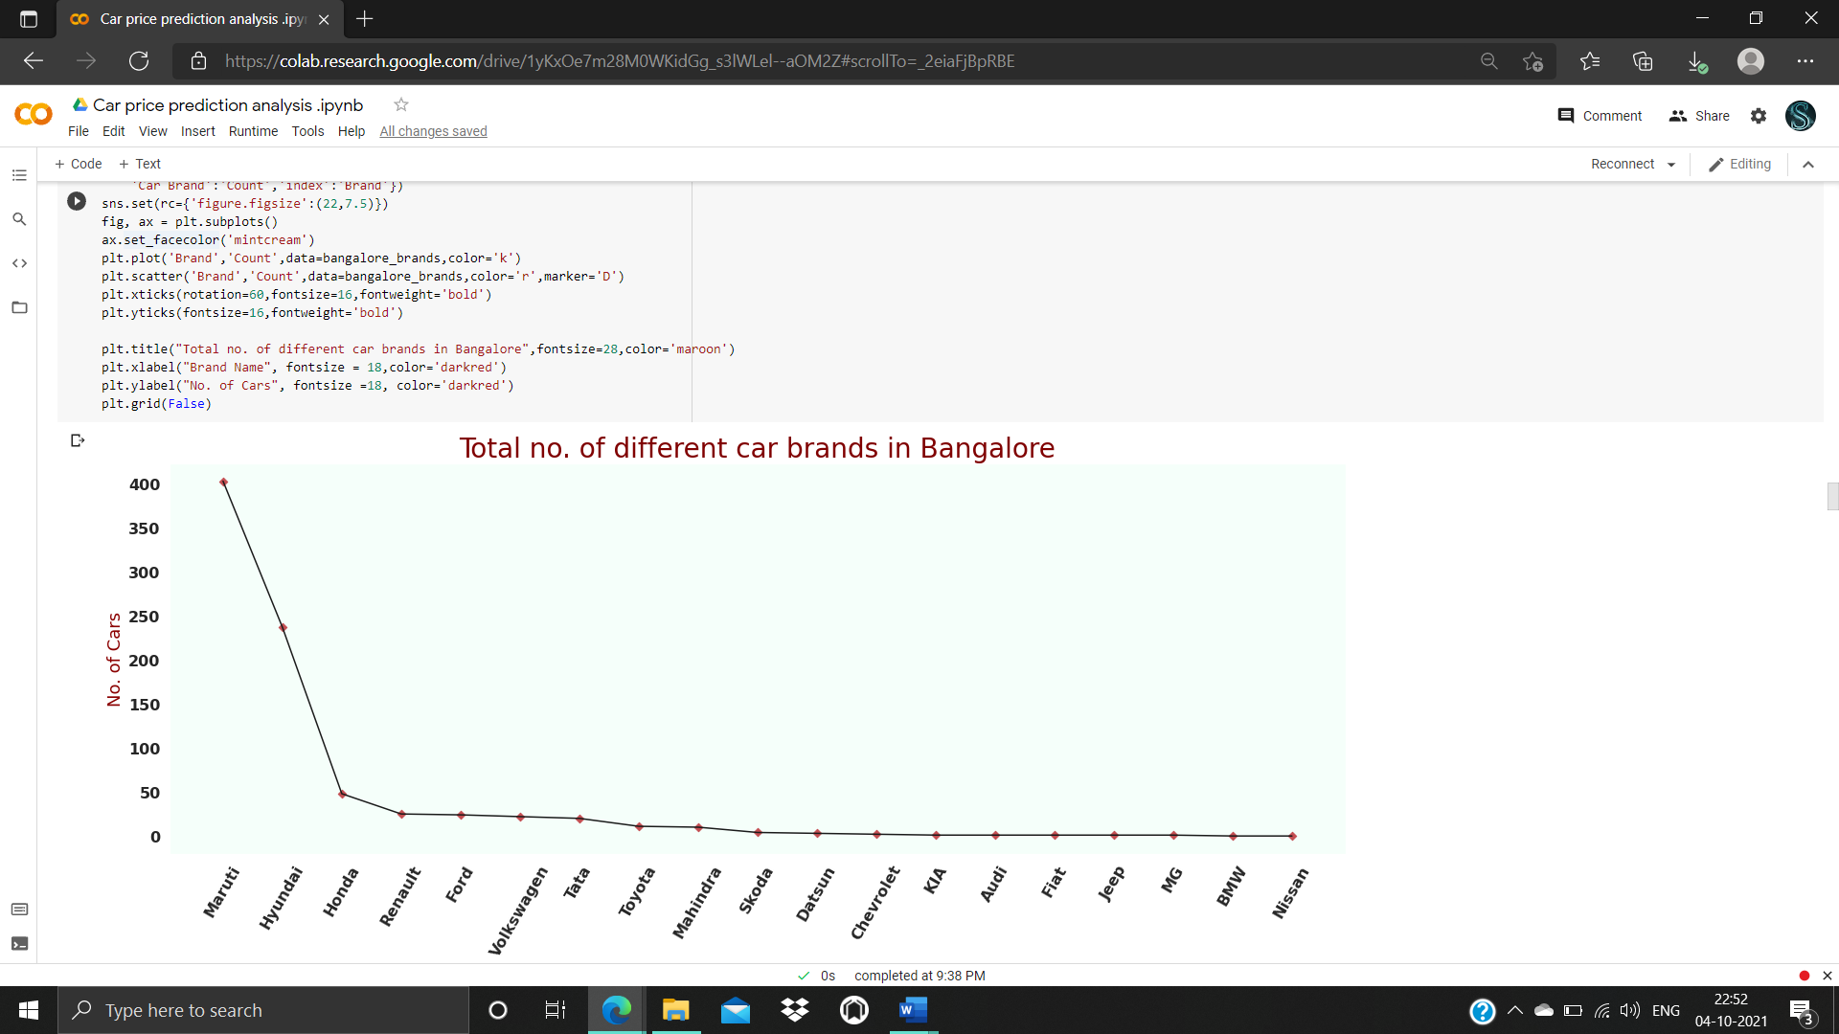

Slide 24
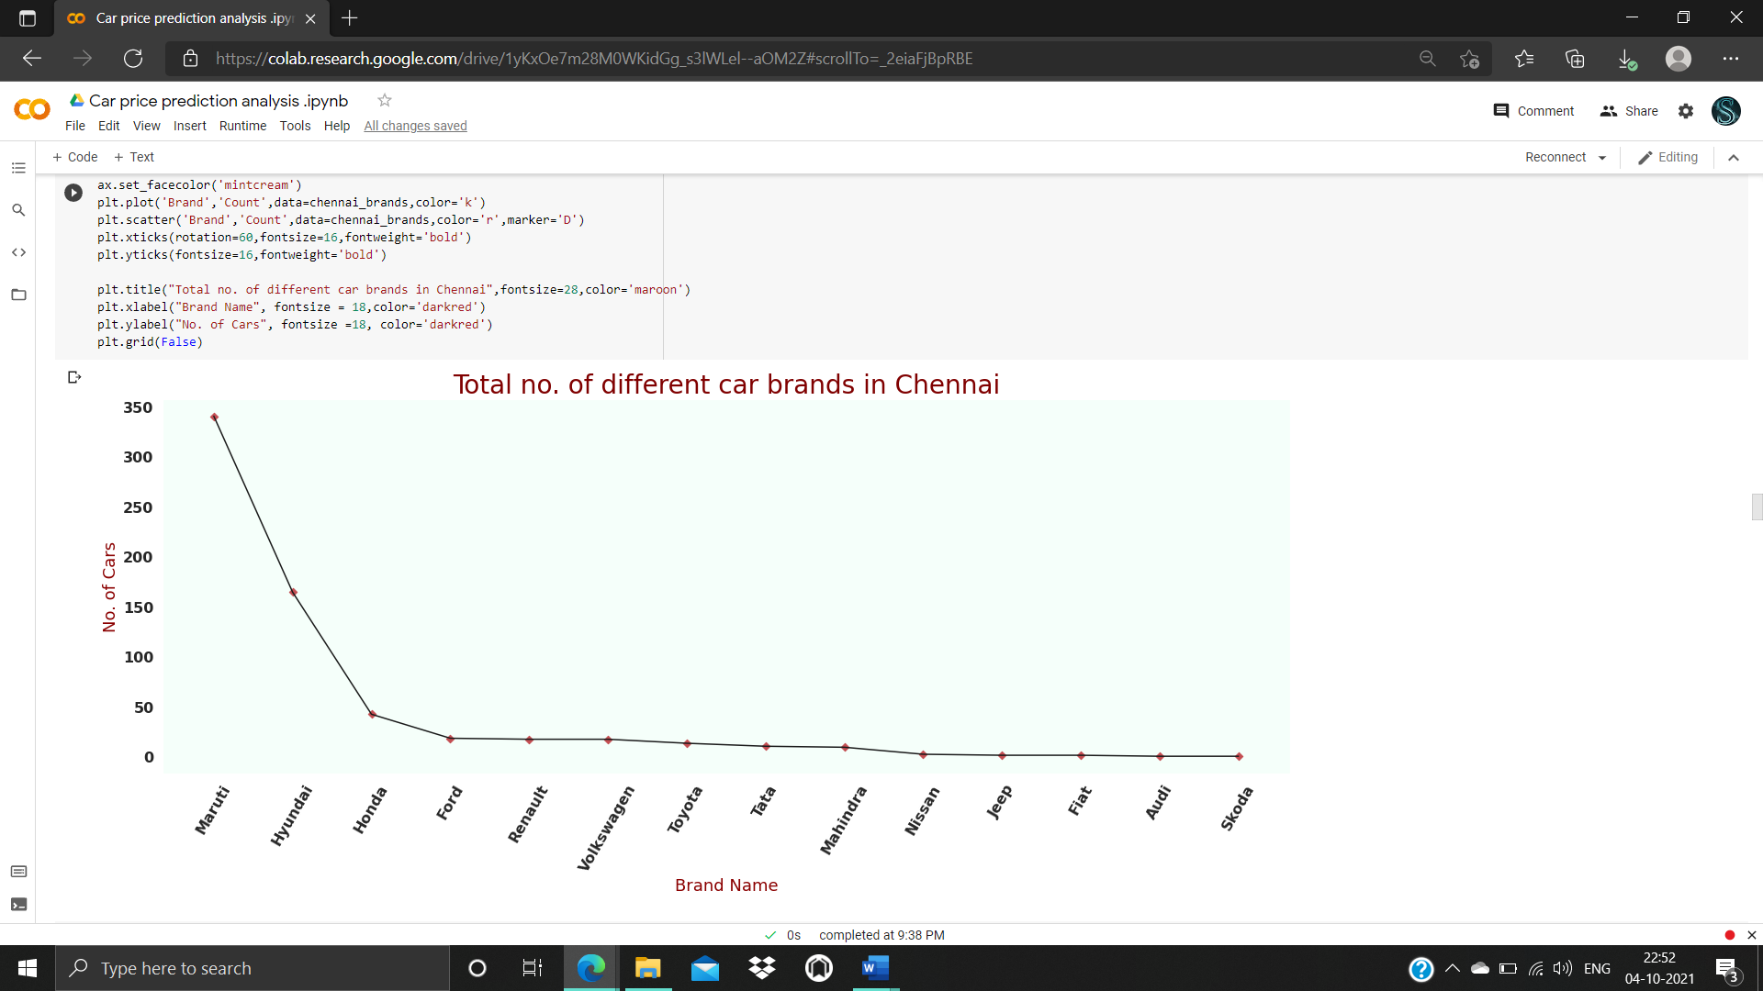

Slide 25
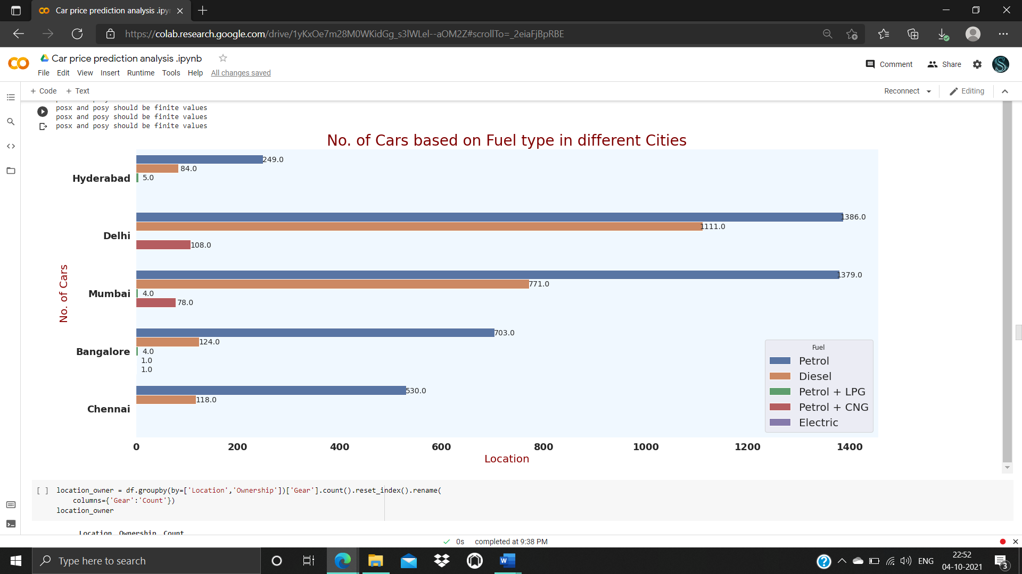

Slide 26
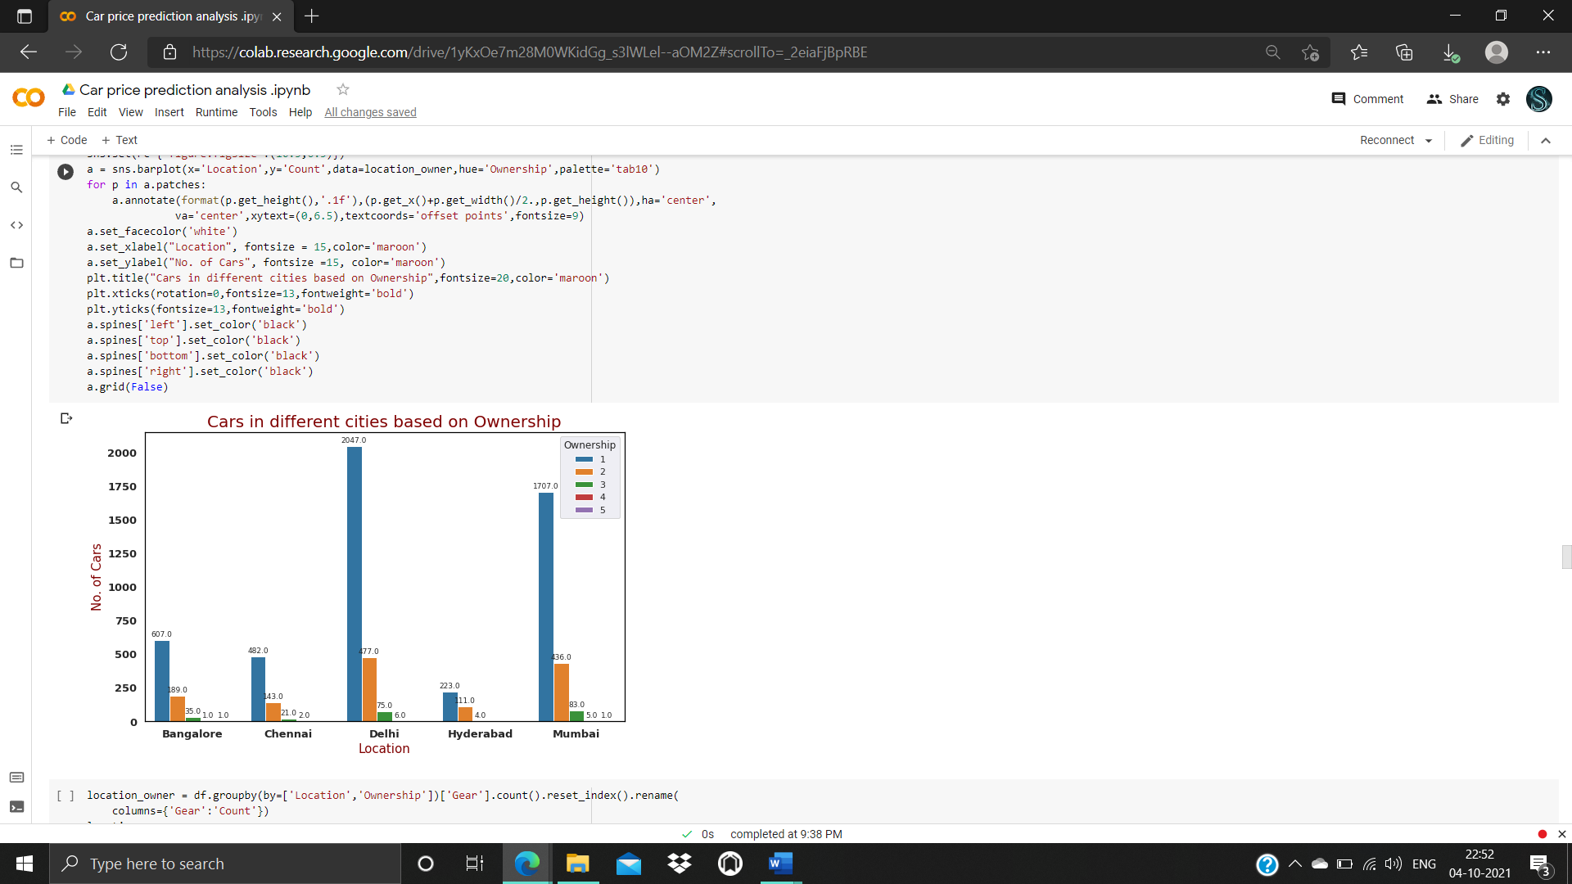

Slide 27
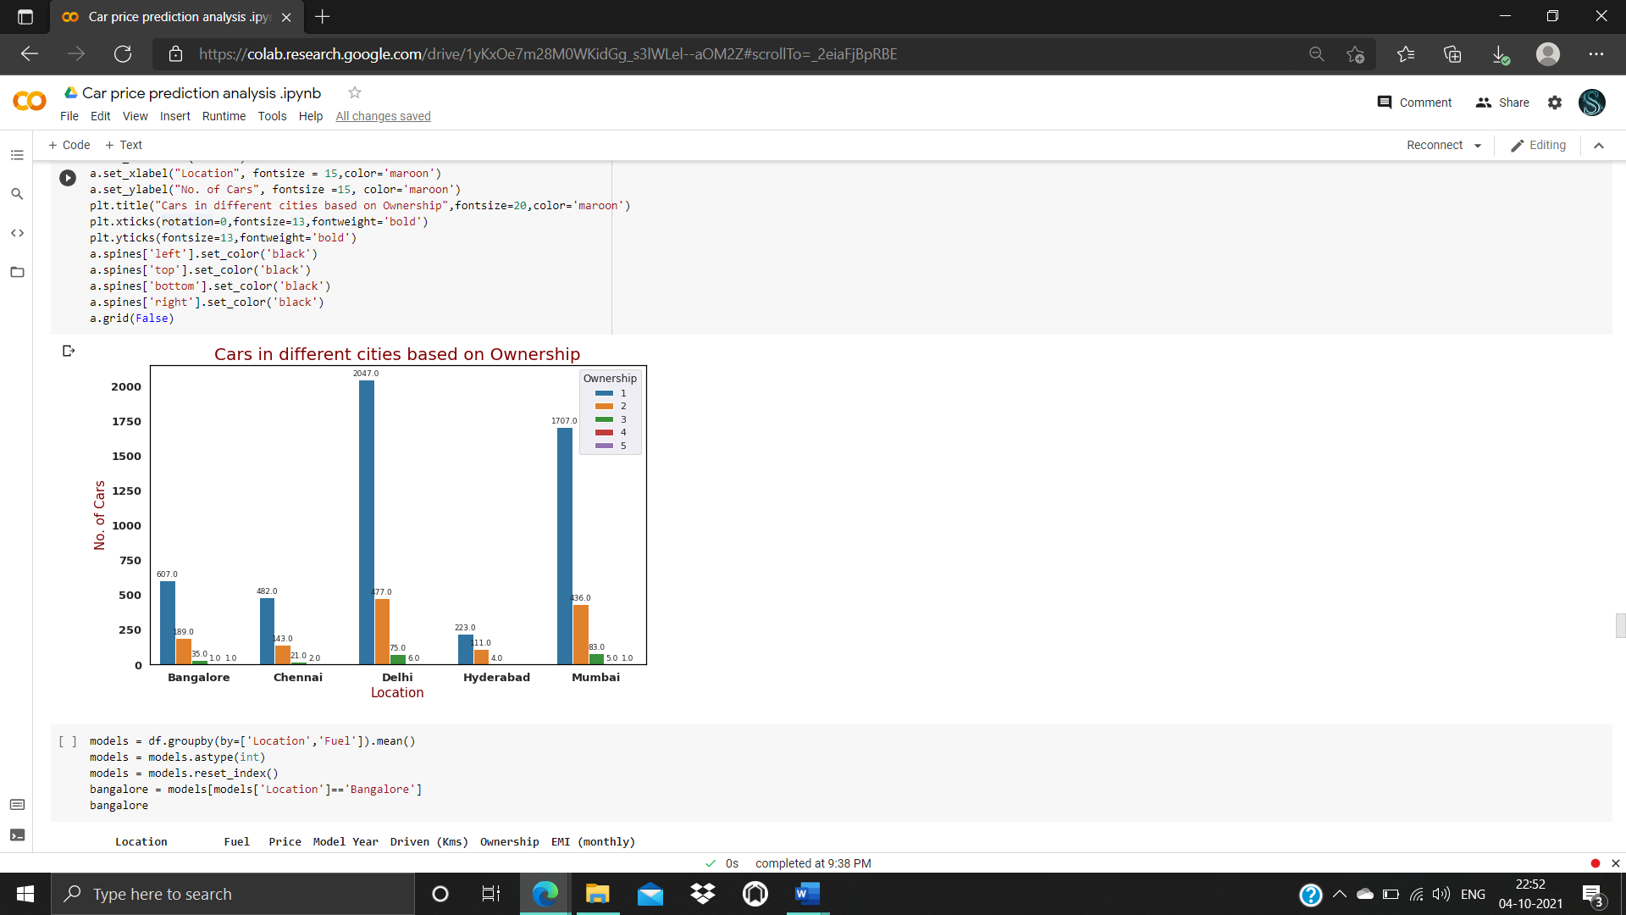

Slide 28
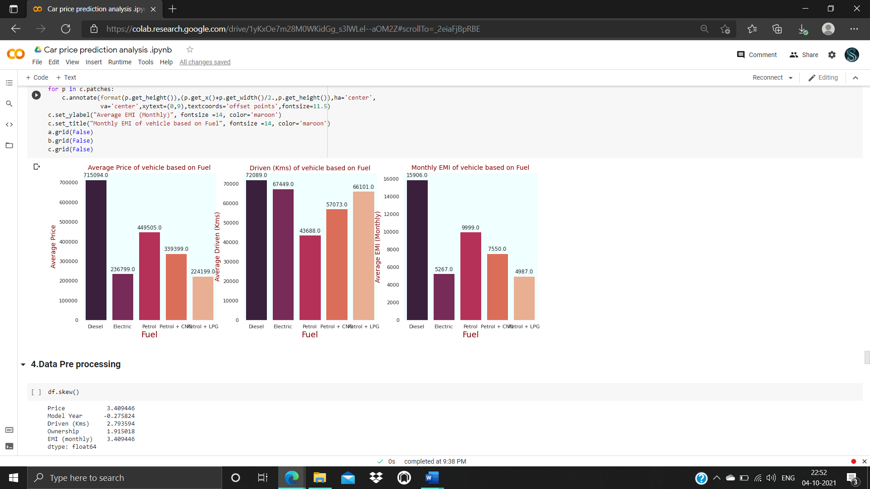

Slide 29
Observations
The availability of cars in 'Delhi'(2200+) is the highest among other 4 cities.
Compared to other 4 cities 'Hyderabad'(415+) has less available cars.
'Maruti' brand cars are widely available with a count of around 2800 cars in all the cities, followed by Hyundai(1240+), Honda(449), Toyota(280+)
Most of the cars runs with 'Petrol' with a count of 3663.
High budget car among all cities:
Toyota Land CruiserLC200 VX 2 PREMIUM (3495000/-), 2010 Model, available in Mumbai
Low budget car among all cities:
Maruti AltoLX (91000/-), 2008 Model, available in Delhi

Slide 30
RESULT
Totally 5 models are performed
Linear regression
Decision tree regressor
Random forest regressor
Gradient Boosting Regressor
Among that models linear regression model is chosen as a best model

Slide 31
Conclusion
I check the data first scraped and uploaded the data in jupyter notebook and than I visualize the features ,Perform the preprocessing in the data and understand the relationship between different features.
I used both train-validation split and the cross validation to evaluate the model effectiveness to predict the target values.
At the end I applied the 4 predictive models in the data.
Then after performing all the model the best model is chosen as linear regression .

Slide 32
THANK YOU

